Slide 1
Neural Network architecture comparison
By- Akarshan Jaiswal

Slide 2
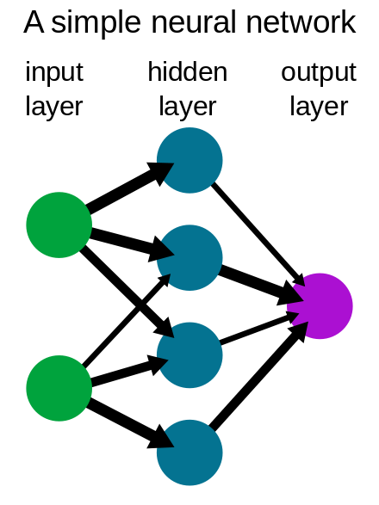

General Approach
Implement different neural networks and training/retraining them.
Evaluating models

Slide 3
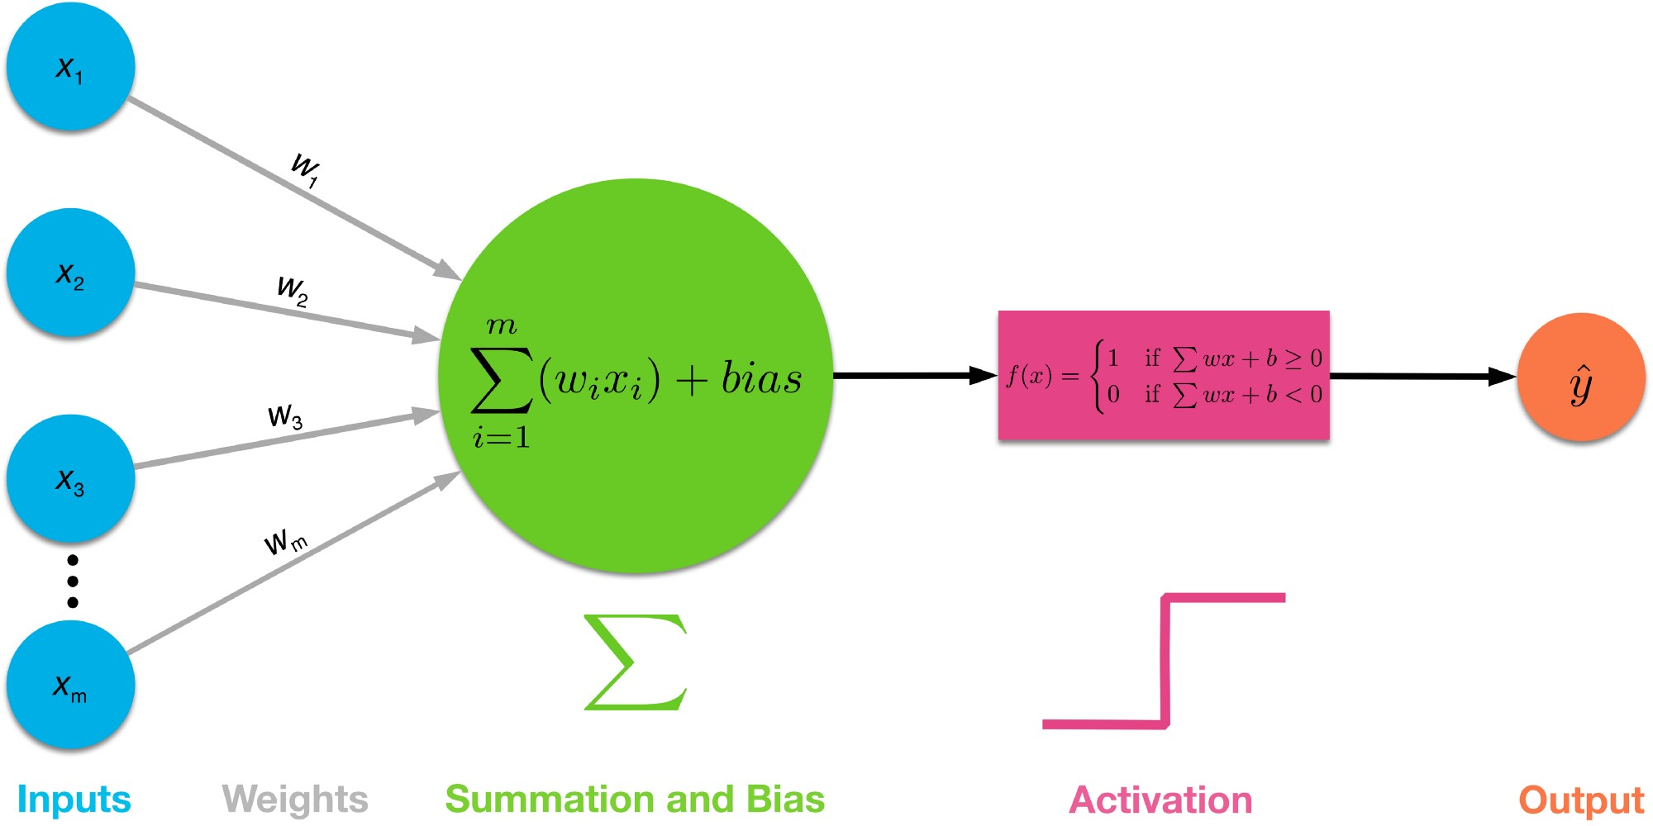
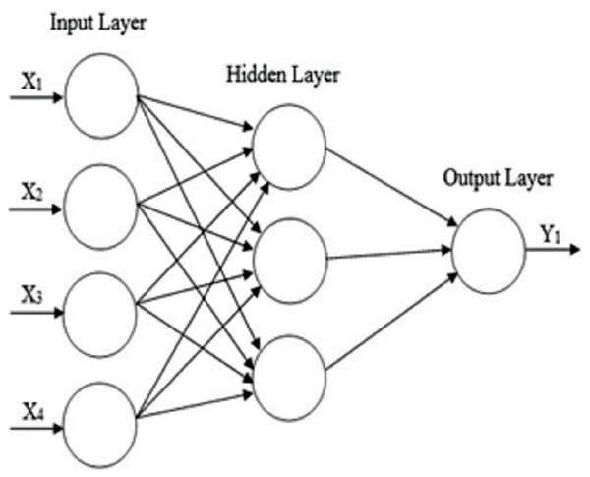
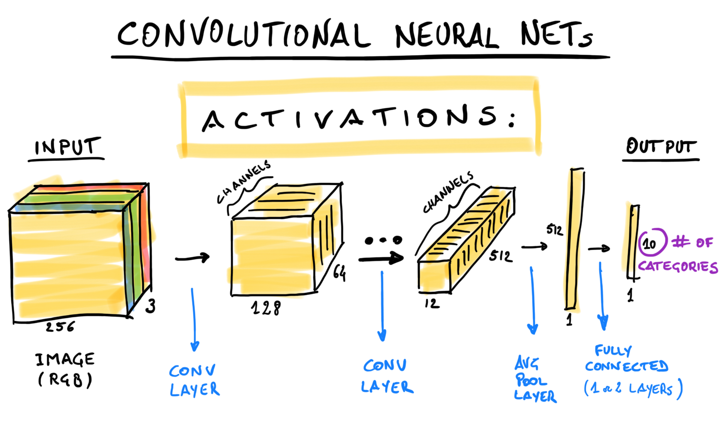
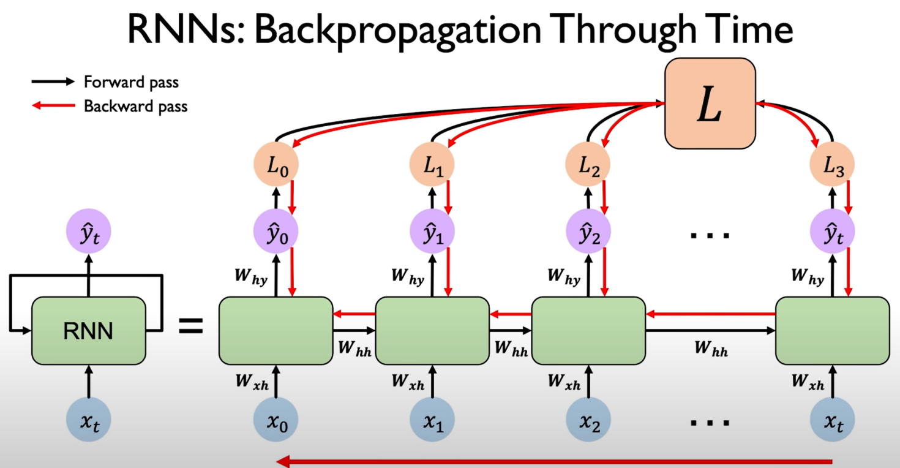
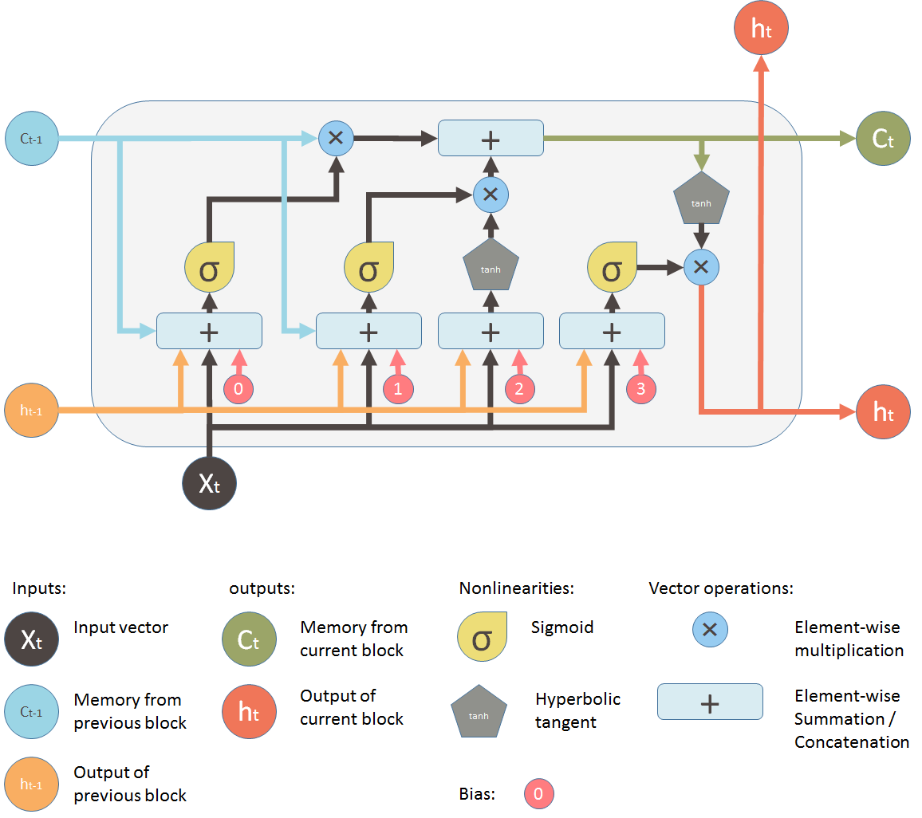
Different Architectures to be implemented.
Feed Forward
Convolutional
Perceptron
Recurrent
LSTM
And more…
This Photo by Unknown Author is licensed under CC BY-SA

Slide 4
Mathematical equation considered ranging from a simple equation to a bit complex equations in nature
a+b
a!
∫a²cos
and many more…..

Slide 5
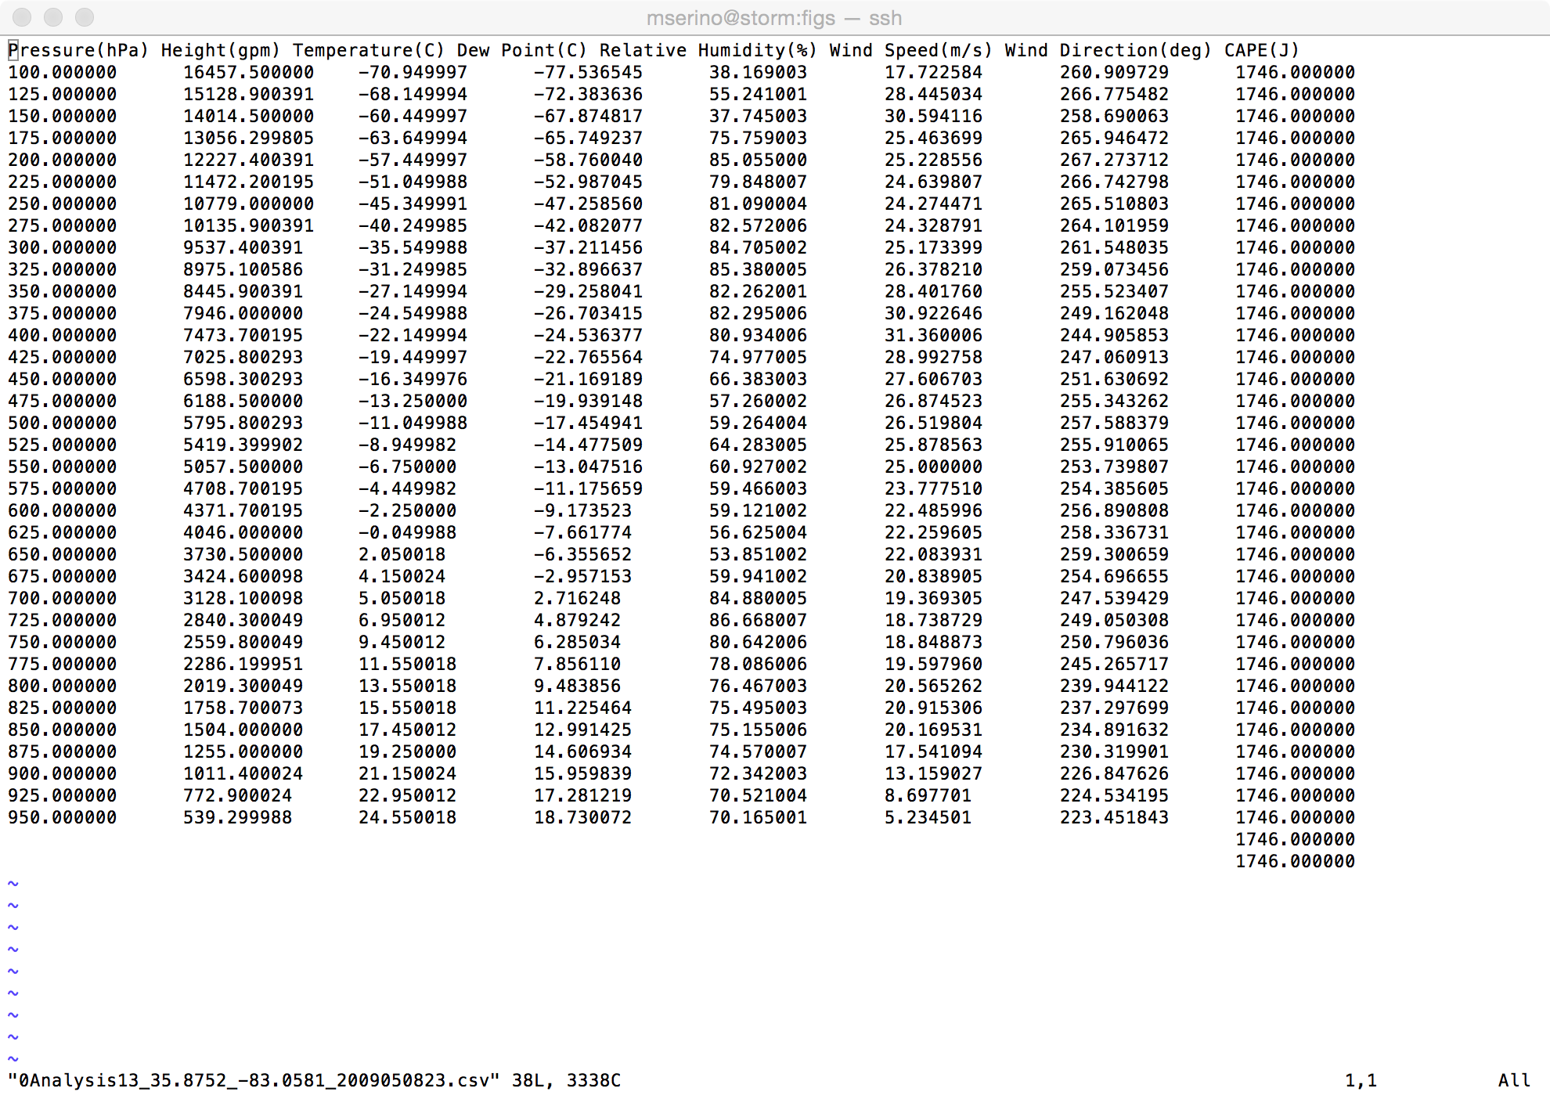


Generating Training Data
Generation of training data is extremely easy.
This Photo by Unknown Author is licensed under CC BY-NC

Slide 6
Evaluation Strategy (Each Neural network)
Train
Yes
Tune
Evaluate
Can it be improved?
Record
No
Retrain

Slide 7
Evaluation Strategy (Whole Project)
Record
Compare
Execute

Slide 8
Thanks
By- Akarshan Jaiswal ( H00425264 ) Email:- aj2059@hw.ac.uk Git-hub:- https://github.com/AkarshanJaiswal/Neural_Network_Architecture_Comparison

